Slide 1

India's Biggest Market Scams
1992 Harshad Mehta Scam
Satyam Scam
Jane Street
Ready Forward Deals | CRR / SLR
7 Jan 2009 | Rs 7,000 Cr+
Rs 40,000 Cr | Index manipulation
20 / 08 / 26

Slide 2

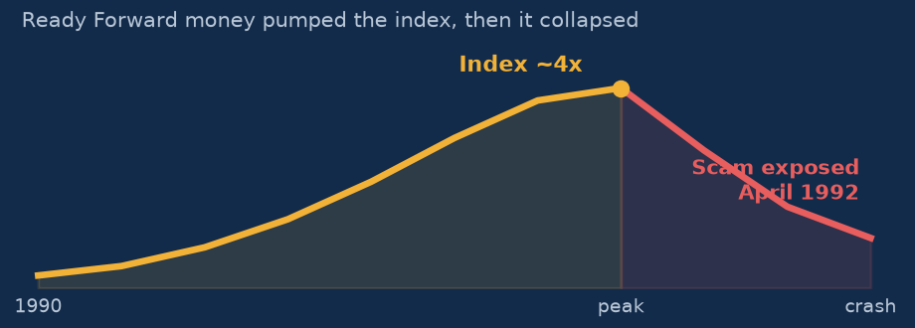
1992 - The Harshad Mehta Scam
Ready Forward Deals: Cash <-> Bank Receipt | The index became 4x | "The Big Bull"
BANKS
BANK RECEIPT
CASH ROUTED
INDEX 4x
Ready Forward deals
run between banks (Short Term 15 Days Interbank Lending)
BR issued without the
actual securities
Bank funds diverted
into the stock market
Index pumped, then it
collapsed on exposure
THE TWO RATIOS HE EXPLOITED
CRR - Cash Reserve Ratio
A certain amount of bank deposits must sit with the RBI, earning 0% interest. Due to increase of CRR from 6% in 1980 to 15% in 1990, current is 3%
SLR - Statutory Liquidity Ratio
A certain amount of deposits must be kept in Government Securities.
"THE BIG BULL" - Harshad Mehta, 1992
MODUS OPERANDI: inter-bank Ready Forward deals became a private cash pipeline -
fake Bank Receipts unlocked bank money with no real collateral, and it pumped select stocks.
Jankiraman Committee’s Report to Parliament, Sucheta Dalal was the journalist
A settlement loophole plus zero
verification equals systemic risk.

Slide 3

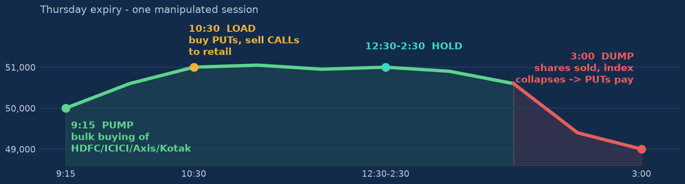
Jane Street - The Rs 43,289 Cr Playbook
NYC-based proprietary High Frequency Trading firm | Trades the owner's money | SEBI barred their profits of 4.8k Cr | main broker: Nuvama
9:15 AM - PUMP
9:15 AM- 11:47AM - LOAD
11:49AM-2:30PM - HOLD
3:00 PM - DUMP
Buying of HDFC / ICICI /
Axis / Kotak Bank in bulk.
Open = Low, so retail
starts going long. In 8 minutes 572 cr stock bought of 6 major BNF.
Index is up. Build big
option positions - buy the
downside lottery (PUT),
sell the upside lottery
(CALL) to retail. 32000 Cr of option positions held in both cases.
The position is simply
held. Index option price
runs about 20x, then ~15x
after 1:30 - averaging
near 10x on cheap puts.
Dump every share bought
in the morning. The index
collapses in minutes, puts
explode 1500-2000% - with
no defined limit.
Index 50,000
Index 51,000
Position held
Index 49,000
RESULT: a slight loss on the
cash stocks, a huge profit on the options.
FOR THE INDIAN MARKET
Abnormal gains = pump and dump.
F&O Trading is very risky.
Pure market manipulation, timed to Thursday
expiry. SEBI began scrutiny of 3 years of
Jane Street derivatives in 2024. Rival: Millennium.
ALGO / HFT OPTION-SELLING DESK
Structure: 3 group companies routed via Hong Kong and Singapore | 2023-25: $4-5 B earned in India, almost entirely from options trading.

Slide 4

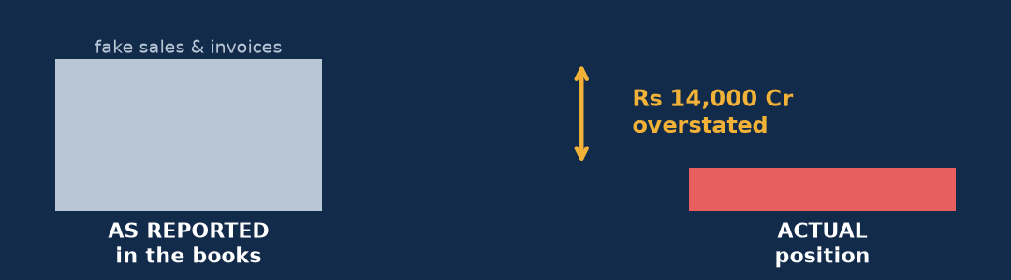
The Satyam Computer Scam - 7 January 2009
India's Elite Money Laundering Scam: Rs 7,000 Cr of overstated financial statements. PwC was the main auditor and SEBI banned them for 2 years
Rs 7,000 Cr+
7 Jan 2009
Tech Mahindra
Scale of the fraud
The confession letter
Acquired and revived it
HOW IT WAS DONE
1
Overstating the financial statements, year after year
2
Fake sales entries and fabricated invoices
SATYAM WAS ACQUIRED BY TECH MAHINDRA IN 2009
3
Audit and Internal Control Failures
"IT WAS LIKE RIDING A TIGER"
Once the fraud started, getting off meant being eaten -
every fake quarter had to be covered by a bigger one.
Takeaway: audit quality is a retail investor's last line of defence - the same pattern echoed later in the BYJU'S crisis.

